Slide 1
POS System
Made By: Hamza AbuQwaider

Slide 2
Introduction
Point of Sale (POS) is a website to store items in the stock, process transactions and track quantity in the inventory. The system allows users to use according to their permissions given by the admin. This application Online and the website can be opened from anywhere in the world.

Slide 3
Problem Statement
HTU Store uses the manual method to store transactions and stock, this method is inefficient because it may increase the incidence of mistakes, takes a long time and consumes effort.

Slide 4
Objectives
Login
Informative dashboard
Selling dashboard
Stock management page
Transactions management page
Users’ management page
Profile Page

Slide 5
System Analysis
1-Admin: can access everything.
2-Seller: can access only Selling dashboard.
3- Procurement: can access only Stock management page.
4-Accountant: can only access Transactions management page.
5-Security (Login, Hash Password, SQL Injection and XSS)
6- Availability
7-Manitainability

Slide 6
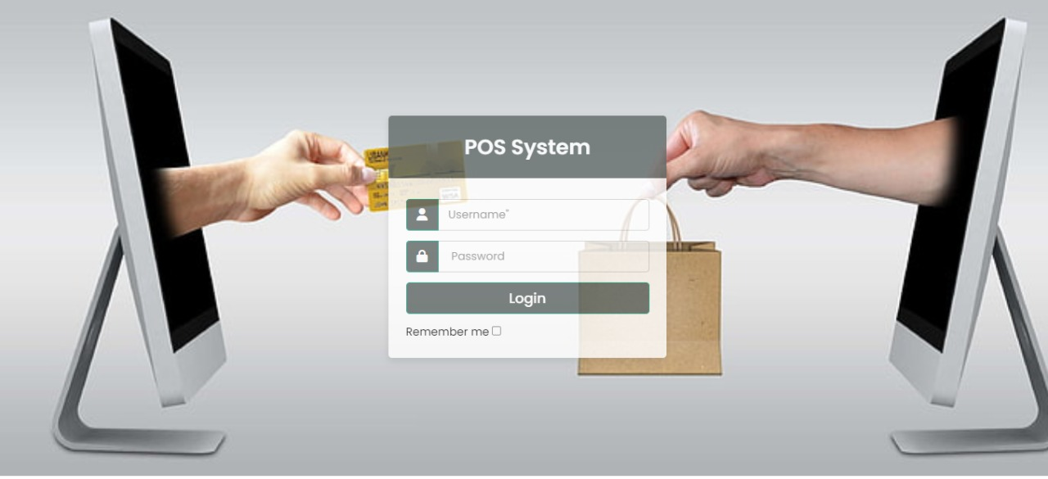
Implementation

Slide 7
Conclusion
Finally, in order to effectively handle customer transactions, track sales and inventory, and provide real-time data to the administrator, HTU's store at King Abdullah Business Park requires the development of a Point of Sale (POS) system. The POS system will increase the store's efficiency, accuracy, and overall customer experience, resulting in increased profits and a stronger competitive advantage. The project's scope includes the creation of a web application that meets these requirements. The POS system will enable HTU to effectively manage its store and drive business success if the project objectives are met.

